Slide 1

Cross-Sell Prediction Hackathon Classification Problem
Prepared by Mohamed Suhaib

Slide 2
Problem Statement
Your client is an Insurance company that has provided Health Insurance to its customers now they need your help in building a model to predict whether the policyholders (customers) from past year will also be interested in Vehicle Insurance provided by the company.
An insurance policy is an arrangement by which a company undertakes to provide a guarantee of compensation for specified loss, damage, illness, or death in return for the payment of a specified premium. A premium is a sum of money that the customer needs to pay regularly to an insurance company for this guarantee.
Building a model to predict whether a customer would be interested in Vehicle Insurance is extremely helpful for the company because it can then accordingly plan its communication strategy to reach out to those customers and optimise its business model and revenue.
Now, in order to predict, whether the customer would be interested in Vehicle insurance, you have information about demographics (gender, age, region code type), Vehicles (Vehicle Age, Damage), Policy (Premium, sourcing channel) etc.

Slide 3
Scope of this project
Using this model, will try to predict whether a Probability of Customer being interested in Vehicle Loan in the test set will be 1 : Customer is interested, 0 : Customer is not interested after the evaluation process.
Data set provided
train.csv - 381109 records with 12 columns
test.csv - 127037 records with 11 columns

Slide 4
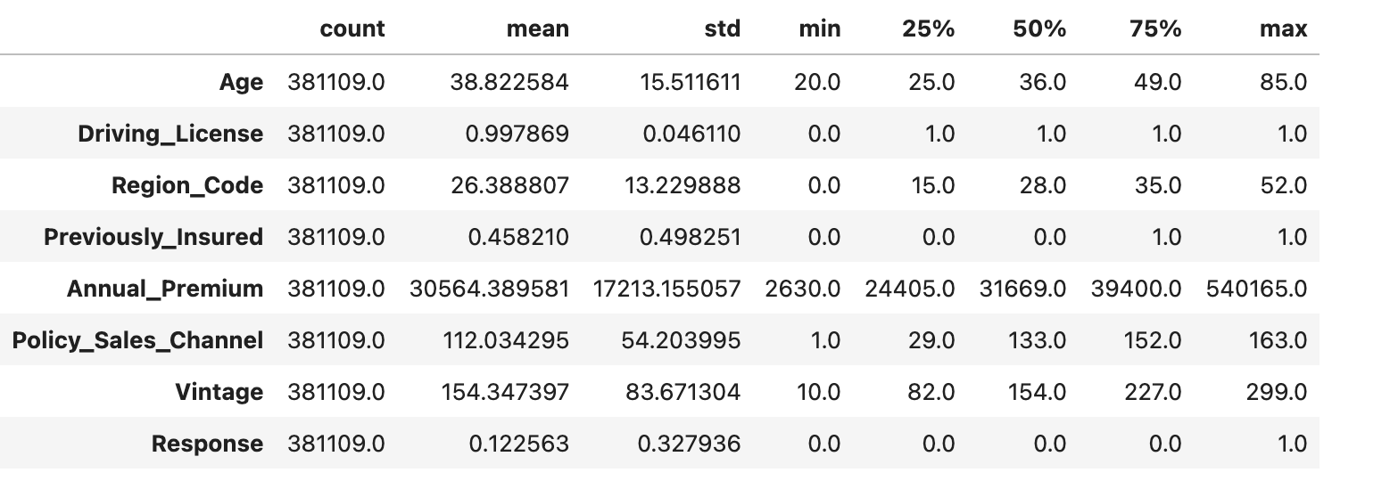
Observation:

Slide 5
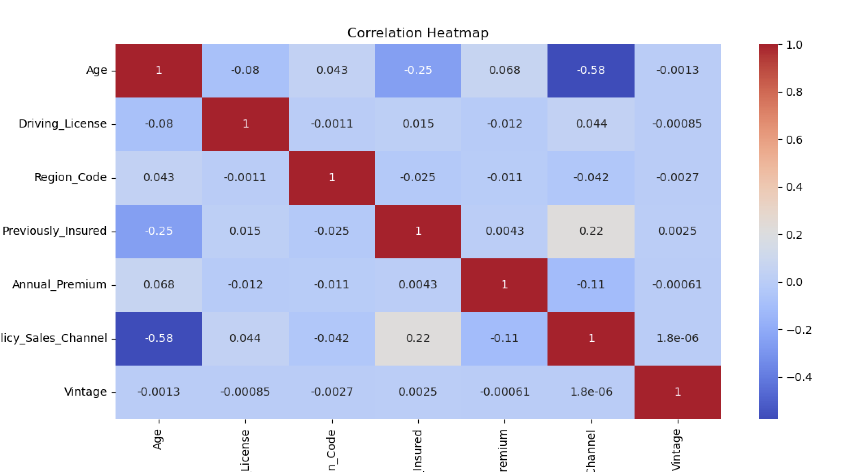
Correlation Heatmap

Slide 6
category and numeric features
Categorical Columns:
['Gender', 'Vehicle_Age', 'Vehicle_Damage']
Numerical Columns:
['Age', 'Driving_License', 'Region_Code', 'Previously_Insured', 'Annual_Premium', 'Policy_Sales_Channel', 'Vintage']

Slide 7
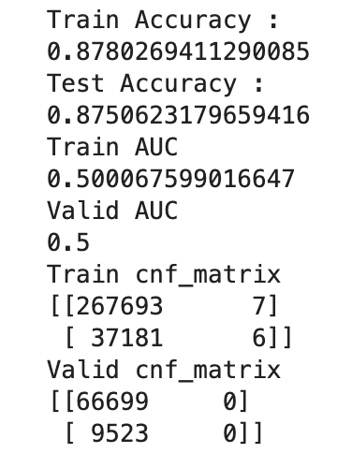
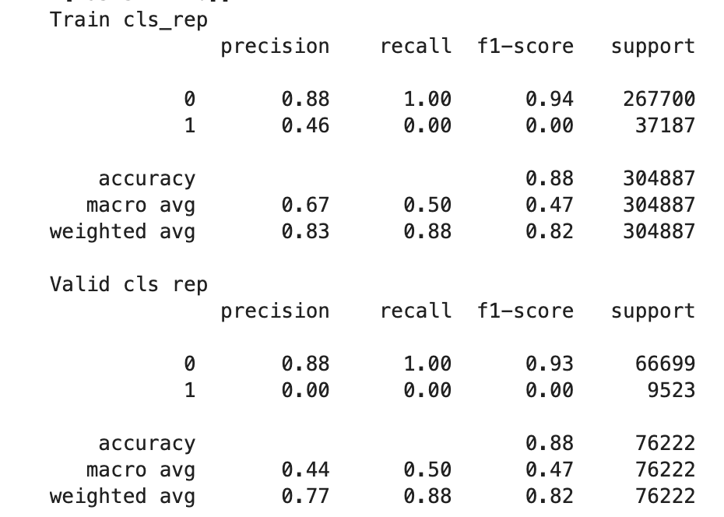
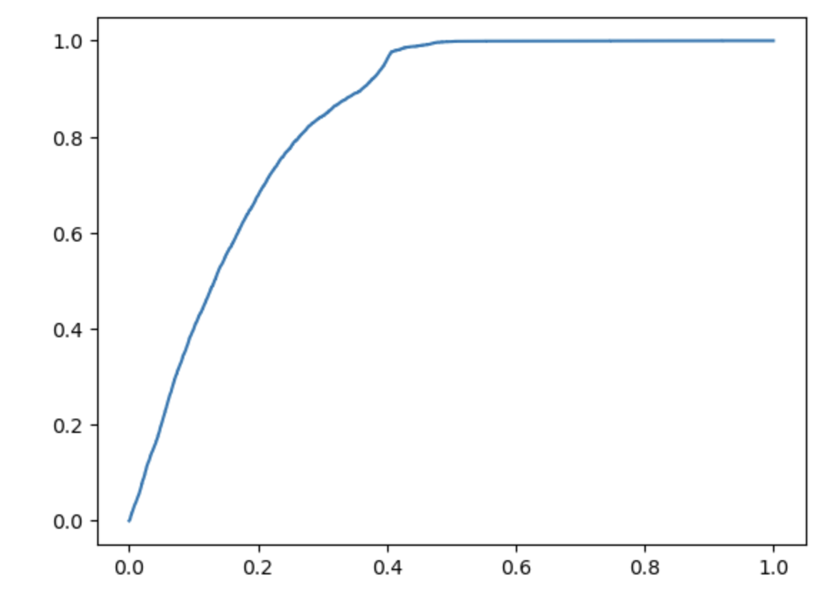
Model Prediction Using Base Model:
Using Logistic Regression:
Train ROC_AUC Score 0.500067599016647
Test ROC_AUC Score 0.5

Slide 8
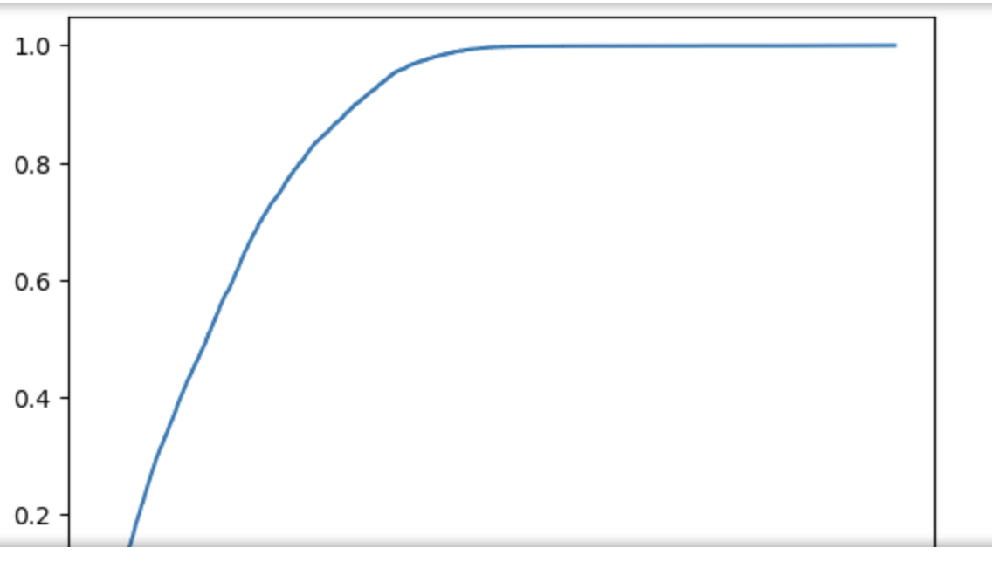
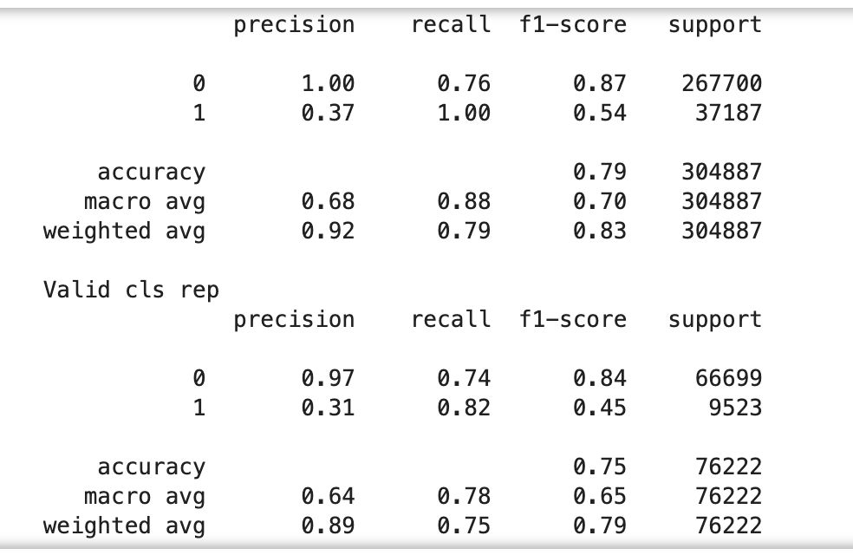
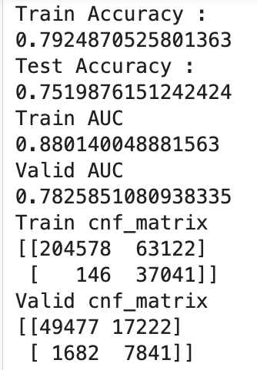
Model Comparison:
Using RandomForestClassifier:

Slide 9
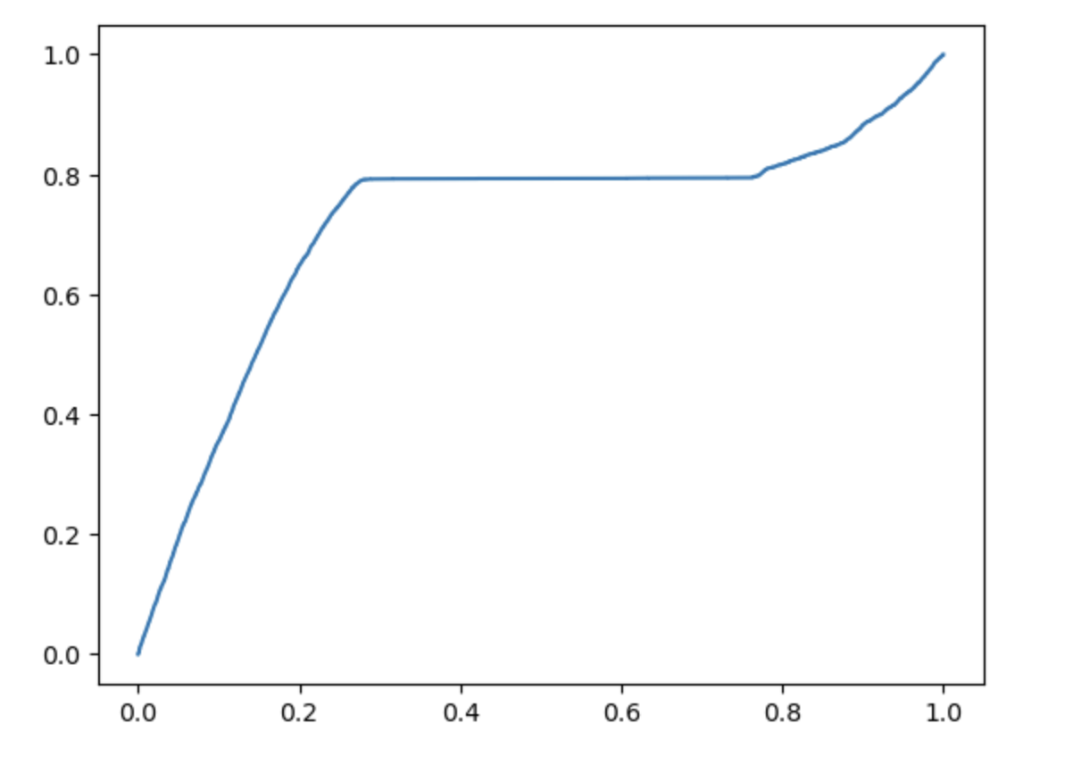
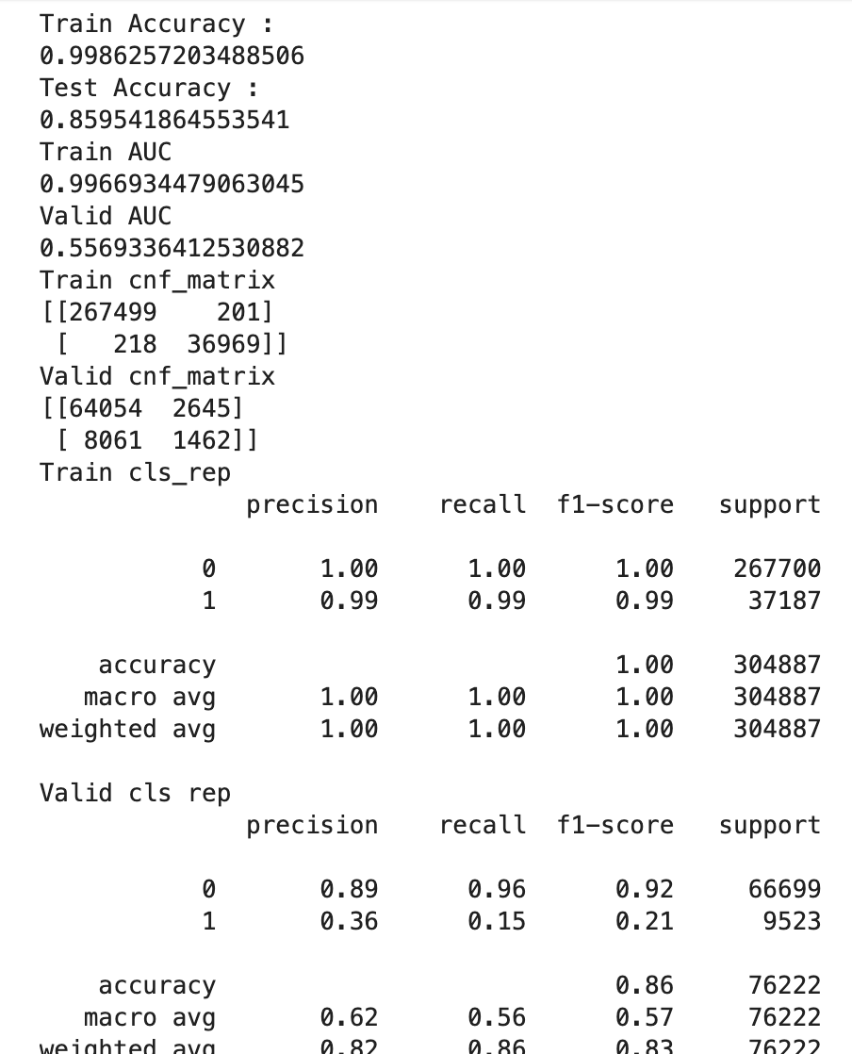
Hyperparameters Tuning for each model
Using StackingClassifier & GradientBoostingClassifier & XGBClassifier & AdaboostClassifier:

Slide 10
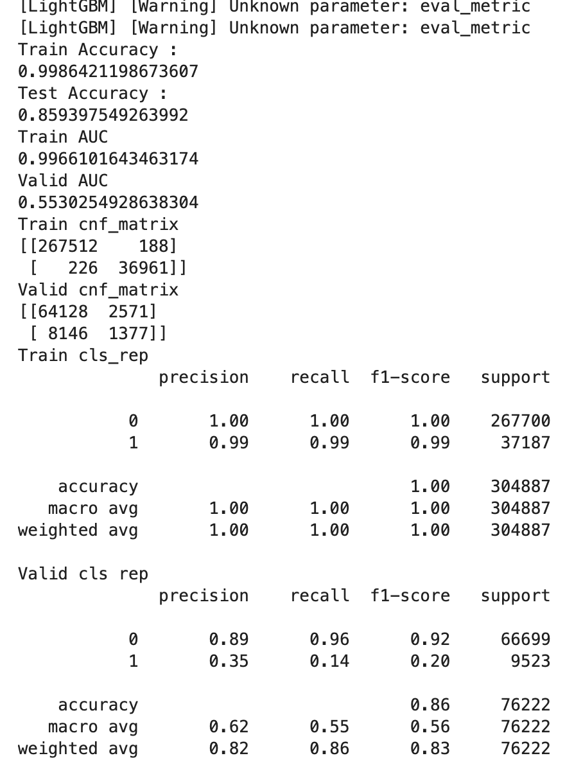
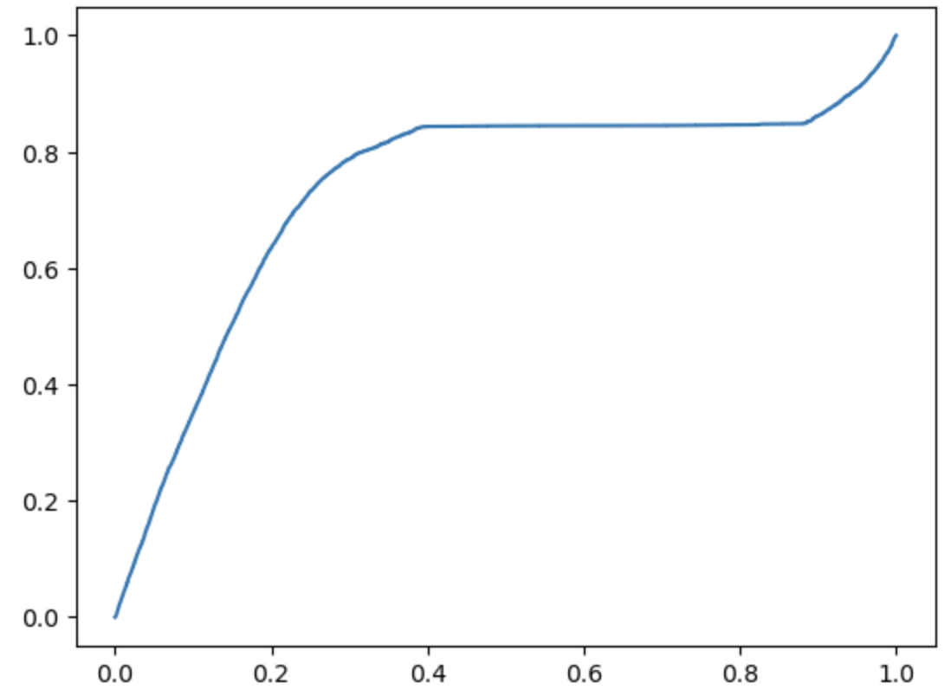
Hyperparameters Tuning for each model
Using StackingClassifier & GradientBoostingClassifier & XGBClassifier & AdaboostClassifier & LGBMClassifier:

Slide 11
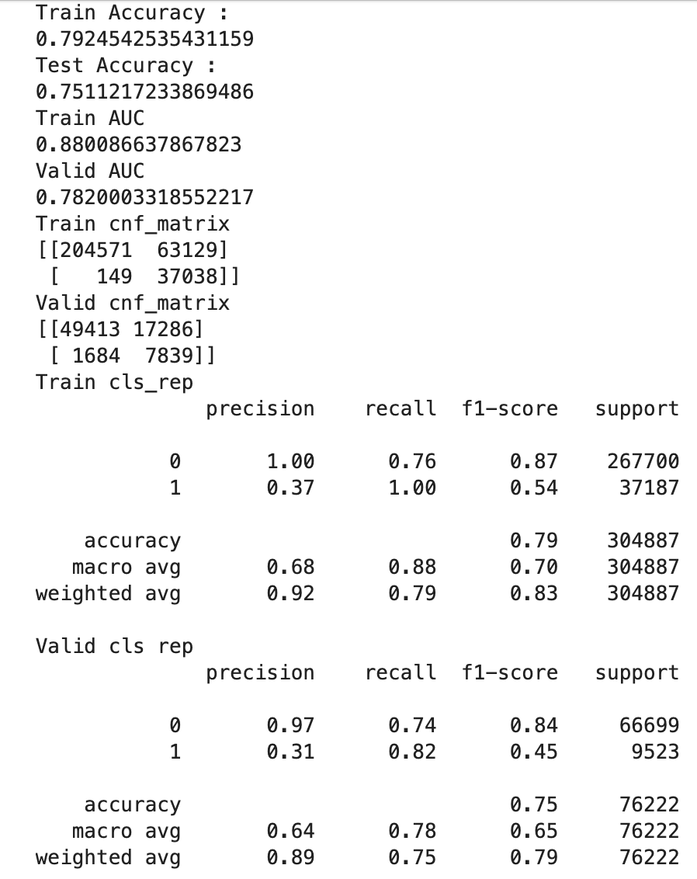
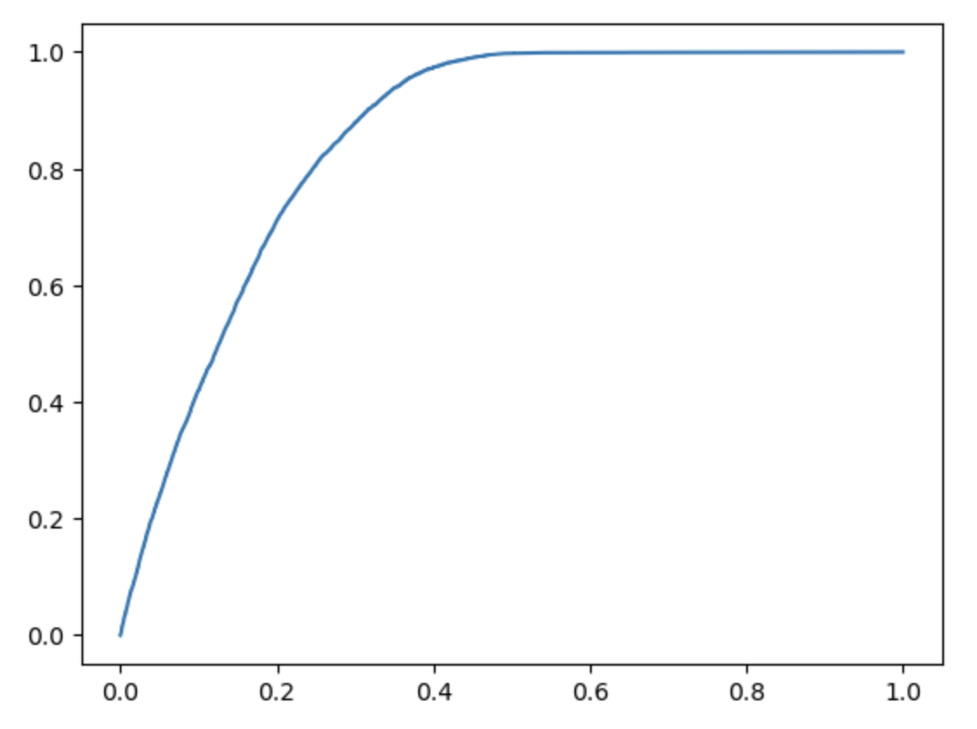
Hyperparameters Tuning for each model
Using StackingClassifier & XGBClassifier & CatBoostClassifier:

Slide 12
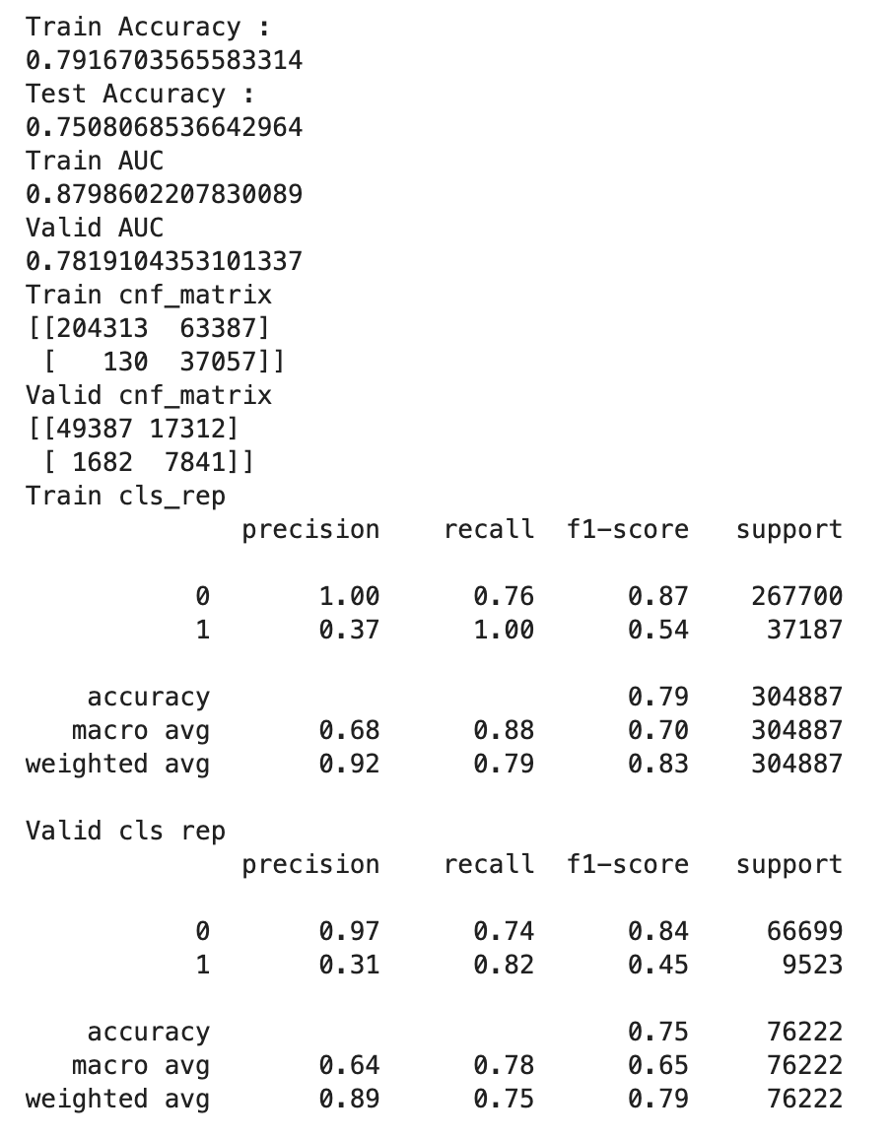
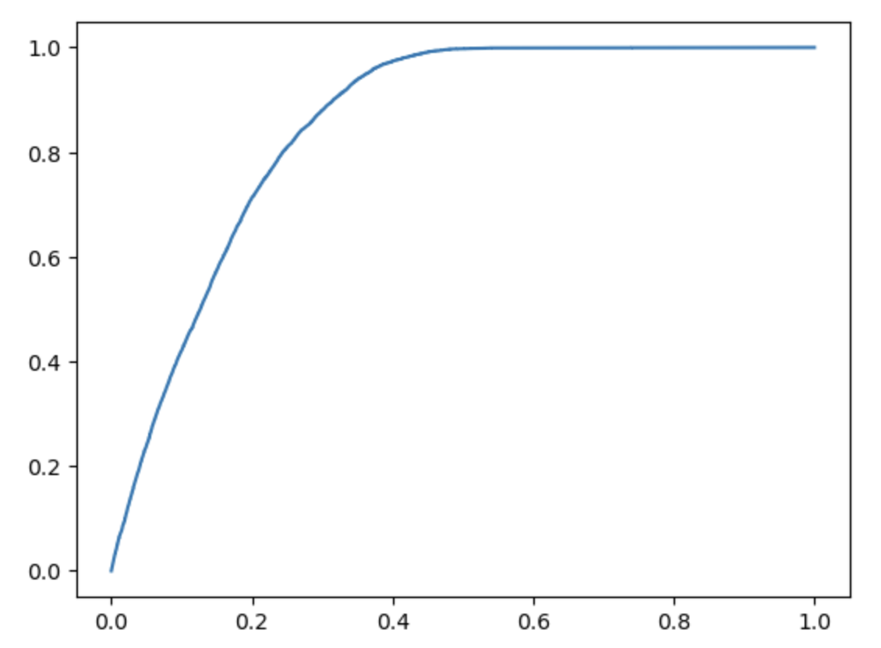
Hyperparameters Tuning for each model
Using StackingClassifier & XGBClassifier & RandomForestClassifier:

Slide 13
Classification Analysis: Applied the following models and scores obtained
Model | ROC_AUC score
LogisticRegression | 0.500056483
DecisionTreeClassifier | 0.782063676
StackingClassifier | 0.78218885
XGBClassifier | 0.782163676
CatBoostClassifier | 0.782227953
RandomForestClassifier | 0.782597639

Slide 14
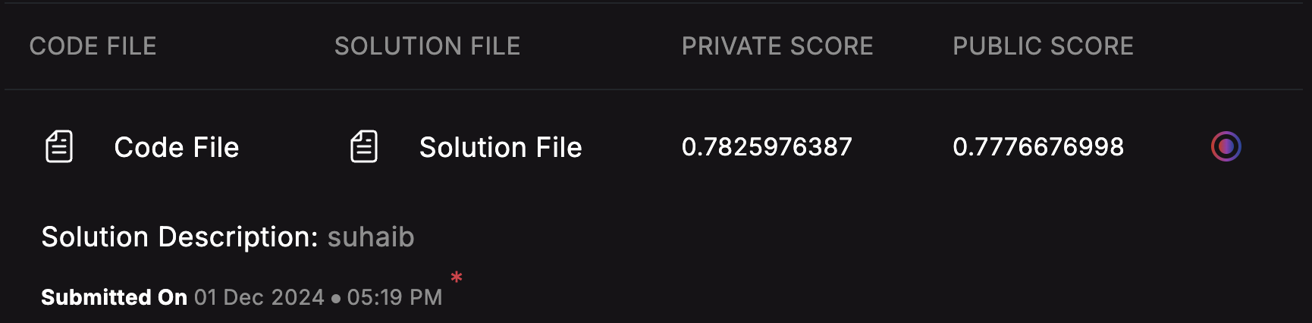
Result uploaded in the analytics vidhya website and the recieved score
Final Evaluation Metric : ROC_AUC score

Slide 15
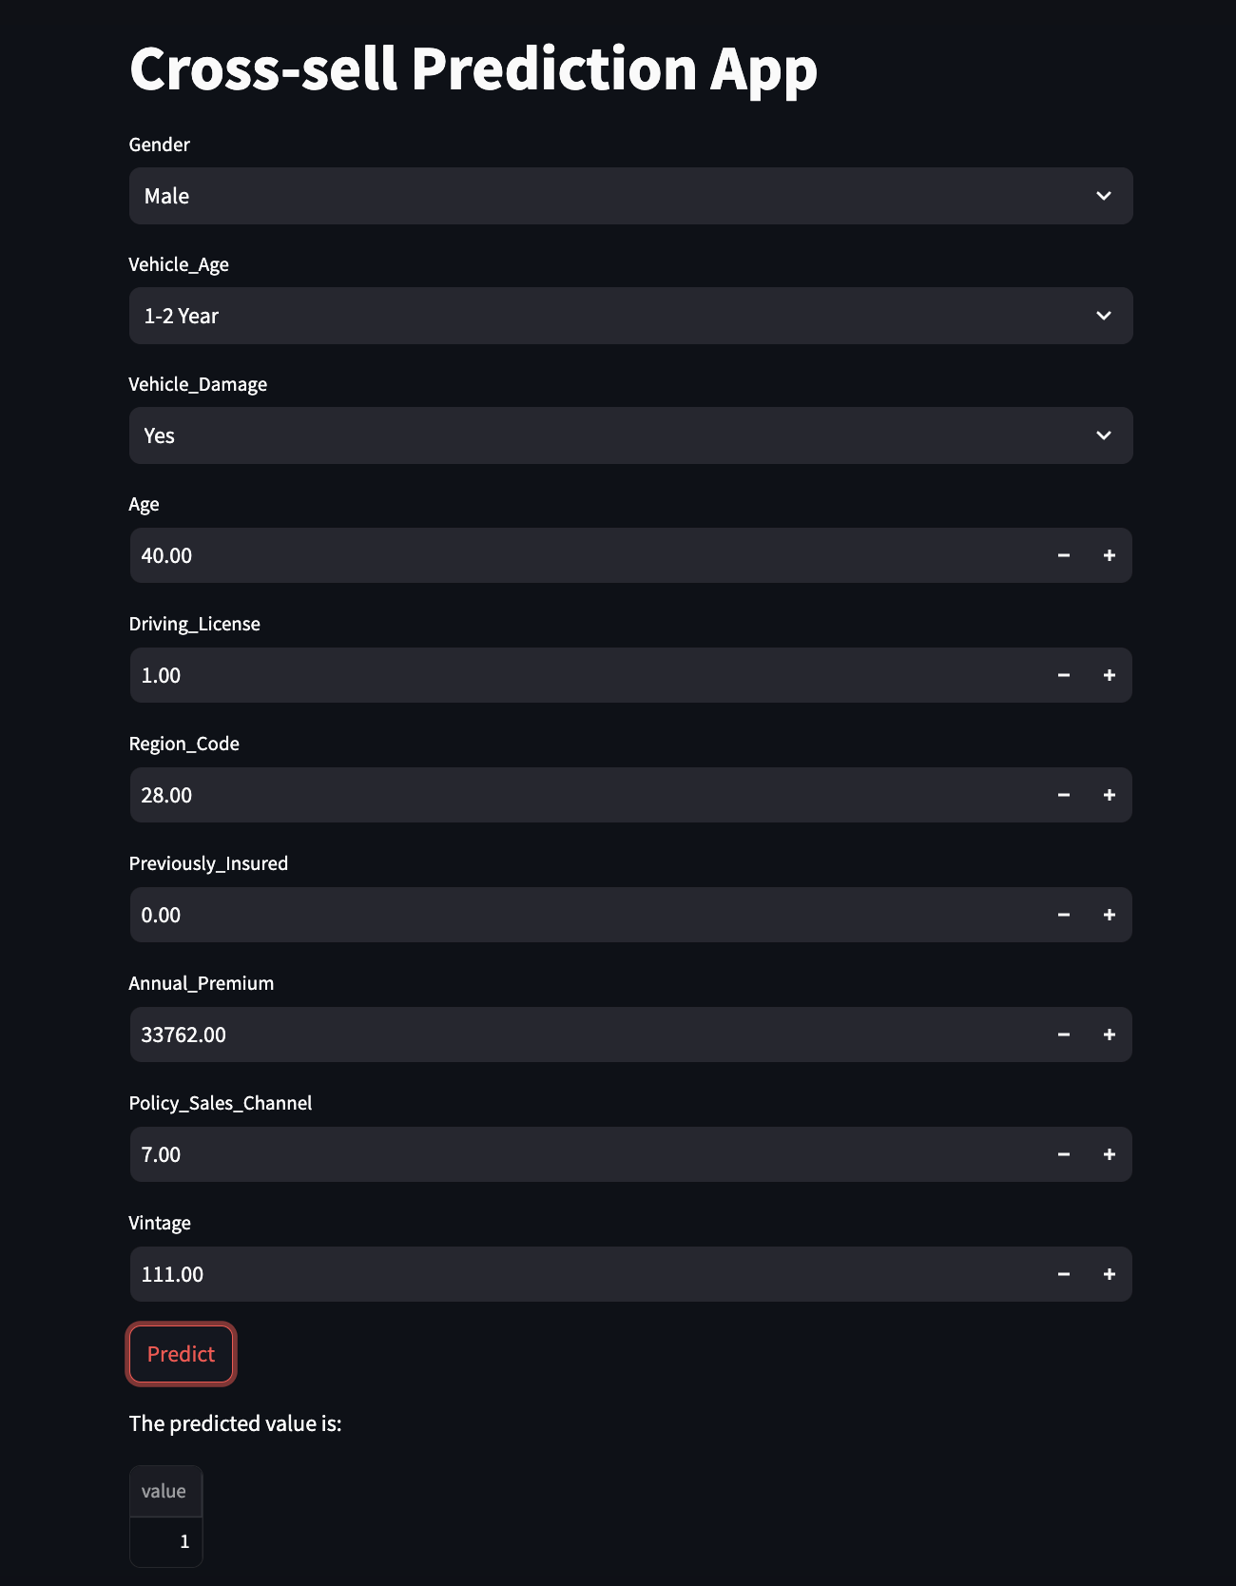
Web API Creation End-Point

Slide 16
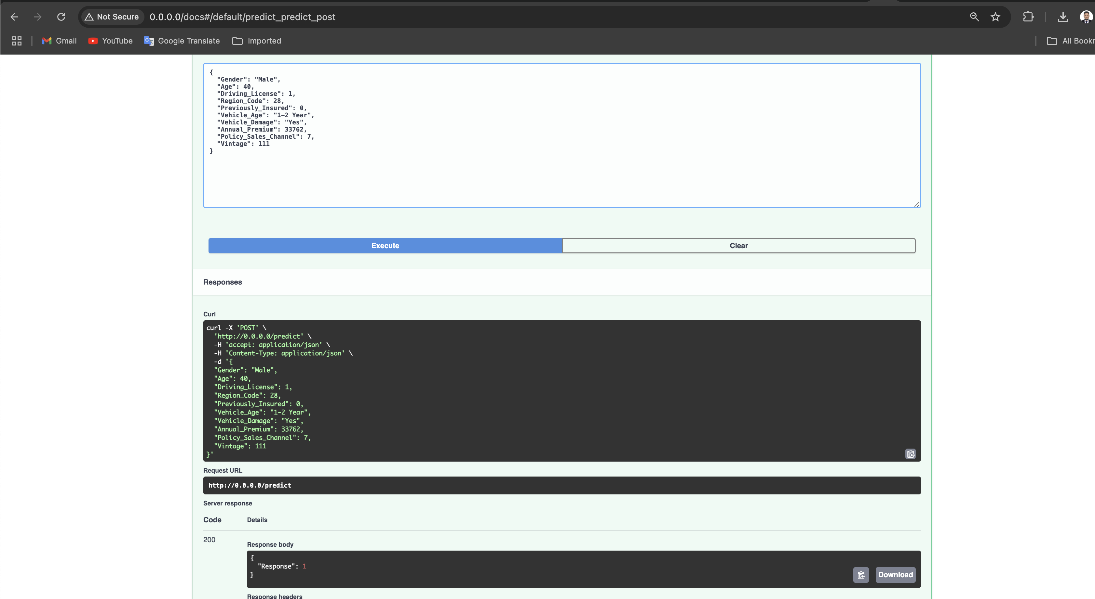
FastAPI Creation End-Point

Slide 17
GCP CloudRun End-Points: FastApi and Streamlit
https://crosssellfastapi-222441656201.us-central1.run.app
https://crosssellstreamlit-222441656201.us-central1.run.app

Slide 18
Github Main URL: https://github.com/mohamedsuhaib88/MLHack2024/tree/main
Github URL for FastAPI CI/CD using GCP CloudRun:
https://github.com/mohamedsuhaib88/crosssellstreamlit/tree/main
Github URL for Streamlit CI/CD using GCP CloudRun:
https://github.com/mohamedsuhaib88/crosssellfastapi/tree/main
DockerHub Image:
msuhaiba/fastapi-crosssell:1.1
msuhaiba/fastapi-crosssellweb:1.2
DockerHub URL:
https://hub.docker.com/layers/msuhaiba/fastapi-crosssell/1.1/images/sha256-482dc6887664a9b2799d87cd34a20db28cd3a1c0c7d7feb8757e4cda2f2bd144?context=repo

